Slide 1
Lecture 1: Introduction
Dr. Alaa Sheta
SCSU
shetaa1@southernct.edu

Slide 2
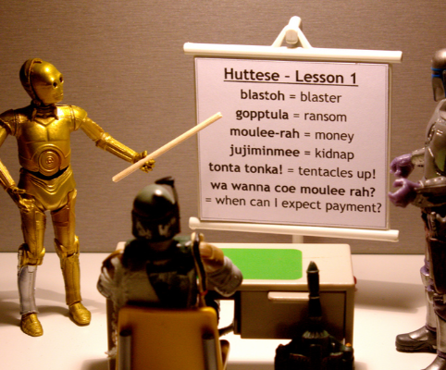
What is NLP
Wiki: Natural language processing (NLP) is a field of computer science, artificial intelligence, and computational linguistics concerned with the interactions between computers and human (natural) languages.

Slide 3
Go beyond the keyword matching
Identify the structure and meaning of words, sentences, texts and conversations
Deep understanding of broad language
NLP is all around us

Slide 4
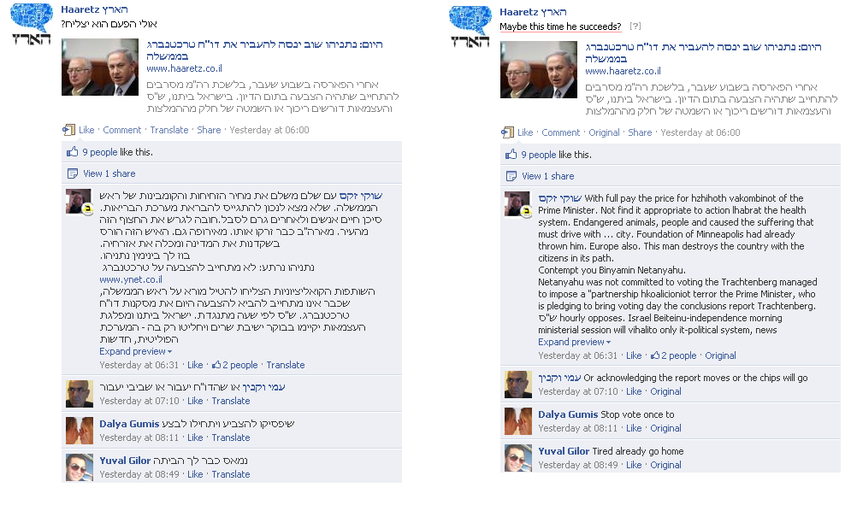
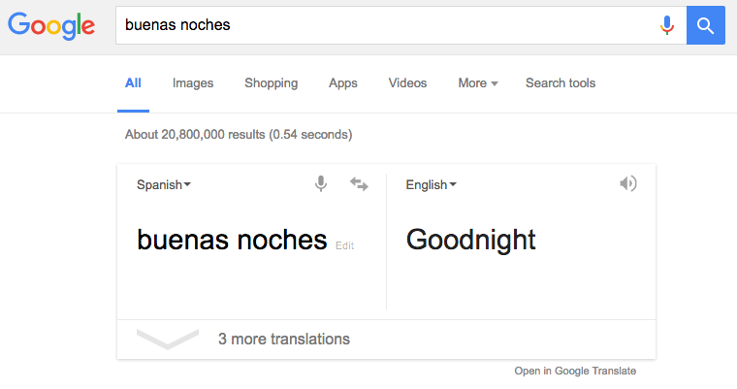
Machine translation
Facebook translation, image credit: Meedan.org

Slide 5
Statistical machine translation
Image credit: Julia Hockenmaier, Intro to NLP

Slide 6
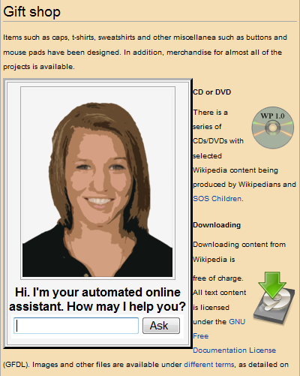
Dialog Systems

Slide 7
Sentiment/Opinion Analysis

Slide 8

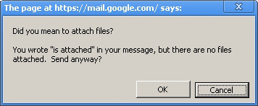
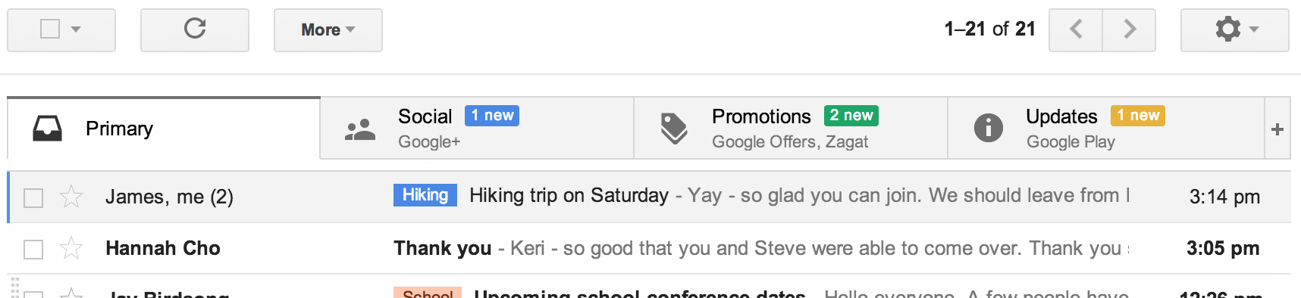
Text Classification
Other applications?
www.wired.com

Slide 9
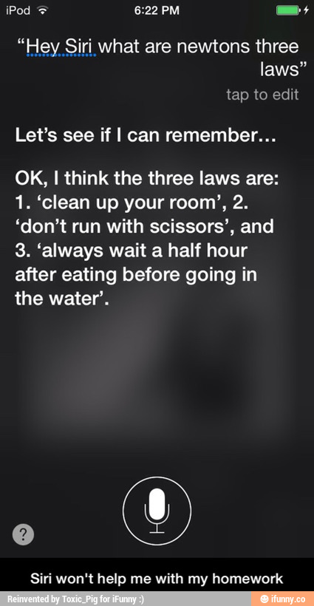
Question answering
'Watson' computer wins at 'Jeopardy'
credit: ifunny.com

Slide 10
Question answering
Go beyond search

Slide 11
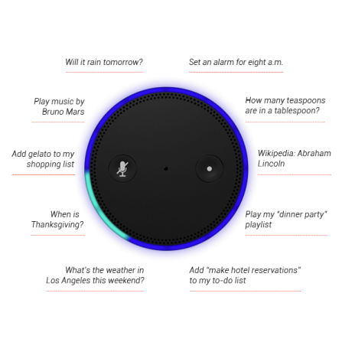
Natural language instruction
https://youtu.be/KkOCeAtKHIc?t=1m28s

Slide 12
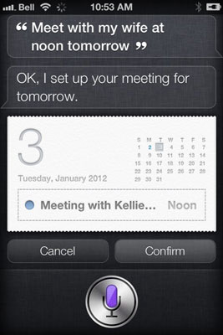
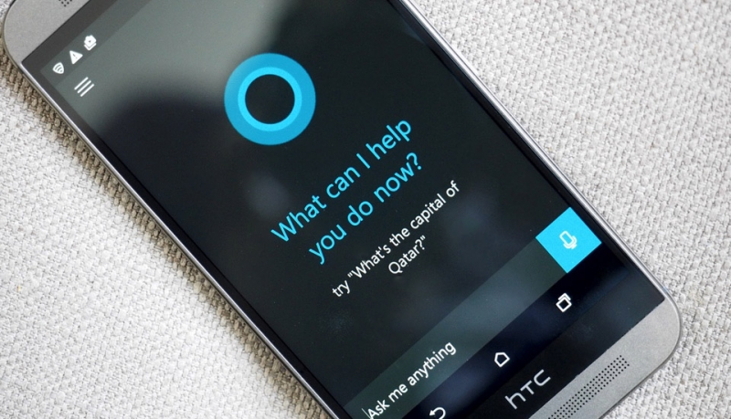
Digital personal assistant
More on natural language instruction
Semantic parsing – understand tasks
Entity linking – “my wife” = “Kellie” in the phone book
credit: techspot.com

Slide 13
Information Extraction
Unstructured text to database entries
Yoav Artzi: Natural language processing

Slide 14
Language Comprehension
Christopher Robin is alive and well. He is the same person that you read about in the book, Winnie the Pooh. As a boy, Chris lived in a pretty home called Cotchfield Farm. When Chris was three years old, his father wrote a poem about him. The poem was printed in a magazine for others to read. Mr. Robin then wrote a book
Q: who wrote Winnie the Pooh?
Q: where is Chris lived?

Slide 15
Challenges
Challenges of NLP

Slide 16
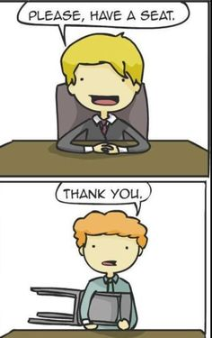
Challenges – ambiguity
Word sense ambiguity

Slide 17
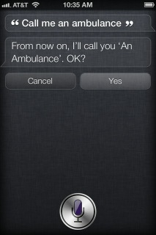
Challenges – ambiguity
Word sense / meaning ambiguity
Credit: http://stuffsirisaid.com

Slide 18
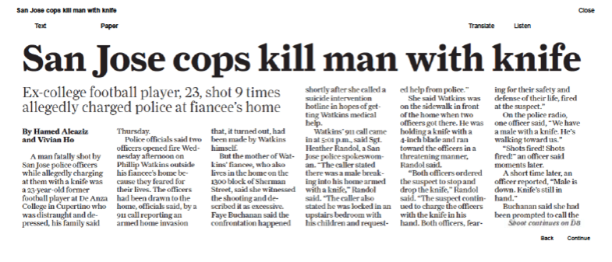
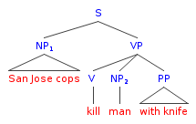
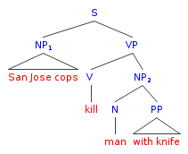
Challenges – ambiguity
PP attachment ambiguity
Credit: Mark Liberman, http://languagelog.ldc.upenn.edu/nll/?p=17711

Slide 19


Challenges -- ambiguity
Ambiguous headlines:
Include your children when baking cookies
Local High School Dropouts Cut in Half
Hospitals are Sued by 7 Foot Doctors
Iraqi Head Seeks Arms
Safety Experts Say School Bus Passengers Should Be Belted
Teacher Strikes Idle Kids

Slide 20
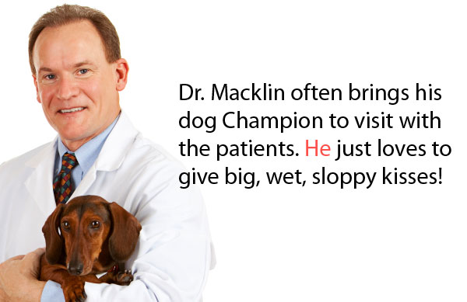
Challenges – ambiguity
Pronoun reference ambiguity
Credit: http://www.printwand.com/blog/8-catastrophic-examples-of-word-choice-mistakes

Slide 21
Challenges – language is not static
Language grows and changes
e.g., cyber lingo
LOL | Laugh out loud
G2G | Got to go
BFN | Bye for now
B4N | Bye for now
Idk | I don’t know
FWIW | For what it’s worth
LUWAMH | Love you with all my heart

Slide 22

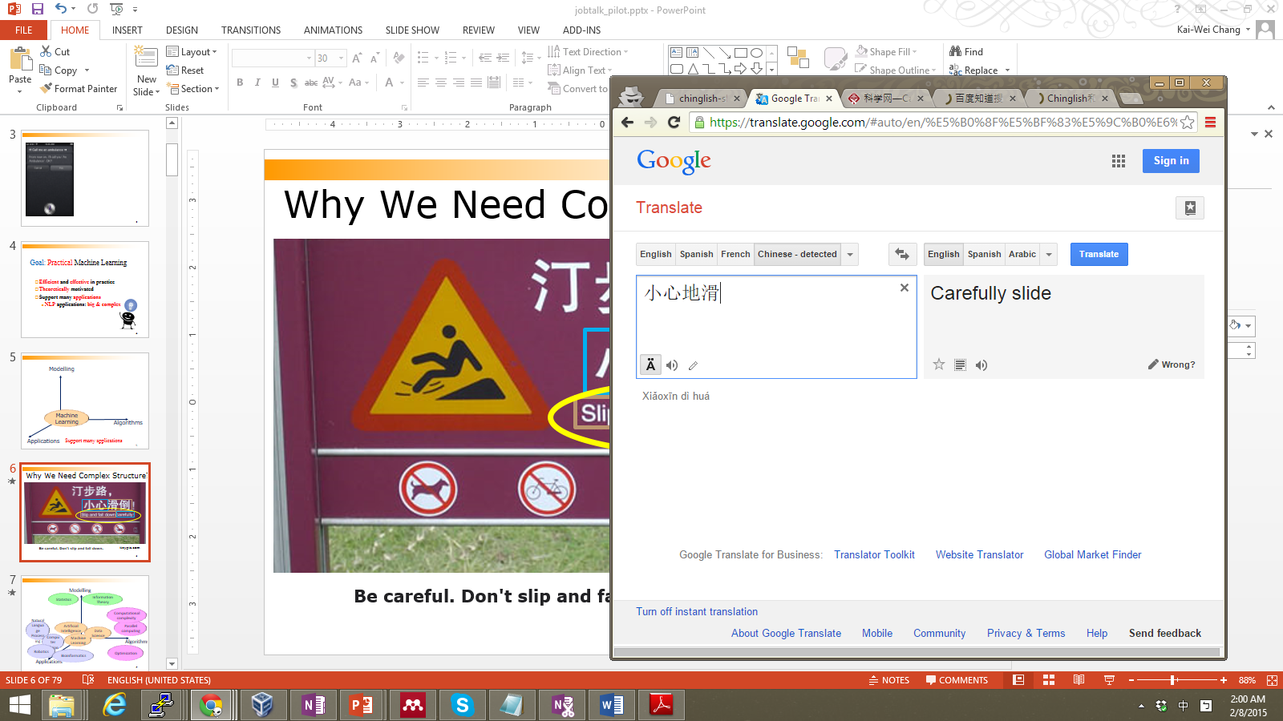
Challenges--language is compositional
Carefully Slide

Slide 23
Challenges--language is compositional
小心:
Carefully
Careful
Take Care
Caution
地滑:
Slide
Landslip
Wet Floor
Smooth

Slide 24
Challenges – scale
Examples:
Bible (King James version): ~700K
Penn Tree bank ~1M from Wall street journal
Newswire collection: 500M+
Wikipedia: 2.9 billion word (English)
Web: several billions of words

Slide 25
This lecture
Course Overview
What is NLP? Why it is important?
What will you learn from this course?
Course Information
What are the challenges?
Key NLP components

Slide 26
Tokenization/Segmentation
Split text into words and sentences
Task: what is the most likely segmentation /tokenization?
There was an earthquake near D.C. I’ve even felt it in Philadelphia, New York, etc.
There + was + an + earthquake + near + D.C.
I + ve + even + felt + it + in + Philadelphia, + New + York, + etc.

Slide 27
Part-of-Speech tagging
Marking up a word in a text (corpus) as corresponding to a particular part of speech
Task: what is the most likely tag sequence
A + dog + is + chasing + a + boy + on + the + playground
A + dog + is + chasing + a + boy + on + the + playground
Det
Noun
Aux
Verb
Det
Noun
Prep
Det
Noun

Slide 28
Named entity recognition
Determine text mapping to proper names
Task: what is the most likely mapping
Its initial Board of Visitors included U.S. Presidents Thomas Jefferson, James Madison, and James Monroe.
Its initial Board of Visitors included U.S. Presidents Thomas Jefferson, James Madison, and James Monroe.
Organization, Location, Person

Slide 29
Syntactic parsing
Grammatical analysis of a given sentence, conforming to the rules of a formal grammar
Task: what is the most likely grammatical structure
A + dog + is + chasing + a + boy + on + the + playground
Det
Noun
Aux
Verb
Det
Noun
Prep
Det
Noun
Noun Phrase
Complex Verb
Noun Phrase
Noun Phrase
Verb Phrase
Prep Phrase
Verb Phrase
Sentence

Slide 30
Relation extraction
Identify the relationships among named entities
Shallow semantic analysis
Its initial Board of Visitors included U.S. Presidents Thomas Jefferson, James Madison, and James Monroe.
1. Thomas Jefferson Is_Member_Of Board of Visitors
2. Thomas Jefferson Is_President_Of U.S.

Slide 31
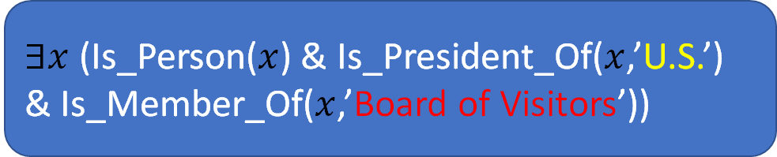
Logic inference
Convert chunks of text into more formal representations
Deep semantic analysis: e.g., first-order logic structures
Its initial Board of Visitors included U.S. Presidents Thomas Jefferson, James Madison, and James Monroe.
$∃x$ (Is_Person($x$) & Is_President_Of($x$,’U.S.’) & Is_Member_Of($x$,’Board of Visitors’))

Slide 32
Questions?

